Slide 1
Driver Distraction & Prediction
Guided : Prof. Kavita Sawant
Created By: Seema Jadhav(4215)
Pratiksha Mesharm(4230)
Gayatri Yadav(4258)
Samruddhi Renakale(4269)

Slide 2
Contents
Problem Statement
Introduction
Scope of Project
Aims and Objective of the Project
System Requirement
Literature Survey
System Architecture
Moduls
UML Diagrams
Algorithms
Project Schedule
Project Plan
Referenses

Slide 3
Problem Statement
To create a project to predict the driver’s ongoing or already finished behaviour to provide safe journey to passanger. This is an application using machine learning to process the image.

Slide 4
Introduction
Distracted driving is a main factor that causes severe car accidents. It has been suggested as a possible contributor to the increase in fatal crashes from 2014 to 2018, and is a source of growing public concern. It is revealed that different distraction activities have different risks of causing accident. Thus, a proper recognition and categorisation of distraction activities via images of drivers in their driving is important. This project focuses on driver distraction activities detection via images using different kinds of machine learning techniques. Our goal is to build a high accuracy model to distinguish whether drivers is driving safely or conducting a particular kind of distraction activity. The input of our model is images of driver taken in the car. We first preprocess these images to get input vectors, then use different classifiers (linear SVM, sofrmax, naive bayes, decision tree, and 2-layer neural network) to output a predicted type of distraction activity that drivers are conducting.

Slide 5
Scope of Project
This Project transverse a lot of area ranging from data analysis of distraction to solution.
The area includes the purpose of distraction
- Outside Object, Event
- Adjusting Radio/ Any Music System
- Using Another Device like phone etc.
- Eating/Drinking

Slide 6
Aims & Objective
Aim
- Our aim is to provide safe journey to passanger.
Objective
The objectives of this project is to overcome the limitations of current computer vision based systems, especially their limitations in hand-crafted feature extraction and generalisation abilities, and to develop accurate and reliable methods using advanced and innovative approaches

Slide 7
System Requirements
Hardware Requirement
- I3 CPU
- Hard Disk 120GB
- Ram 4 GB
Software Requirement
- Windows 10
- Python
- Python IDE
- Web-Browser
- Code Editor
- DataSet

Slide 8
Literature Survey
Sr. No. | Title | Author Name | Year | Methodology
1 | Machine Learning and End-to-End Deep Learning for Monitoring Driver Distractions From Physiological and Visual Signals | - MITJA LUŠTREK PELIN GENC MARTIN GJORESKI JENS-U. GARBAS MATJAŽ GAMS TEENA HASSAN | 2020 | This paper presented an analysis for the determination of which ML methods perform best in detecting various driving distractions using which sensors and which data-capture methods, with a focus on physiological sensors and sensors that are based on video cameras.
2 | Driver Distraction Detection Using Semi-Supervised Machine Learning | Tianchi Liu Yan Yang Yong Kiang Yeo Guang-Bin Huang Zhiping Li | 2015 | provide a promising approach of using SSL in driver distraction detection based on drivers’ eye and head movement data from real driving conditions. By utilizing unlabeled data, the graph-based semi-supervised methods reduce the labeling cost and improve the detection accuracy.
3 | Detection and Evaluation of Driver Distraction Using Machine Learning and Fuzzy Logic | Andrei Aksjonov Pavel Nedoma Valery Vodovozov Eduard Petlenkov Martin Herrmann | 2017 | This paper presents a method for DD detection and evaluation while performing a secondary task. FL fuses the performance-based data to evaluate a level of DD in percentages. The main contribution is solving a regression problem in DD detection and performance-based data fusion into a single variable introduced for the DD assessment. Therefore, the method is capable not only to detect DD, but also to evaluate its influence on safe driving performance.

Slide 9

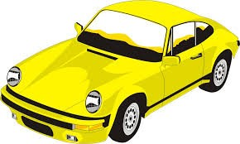
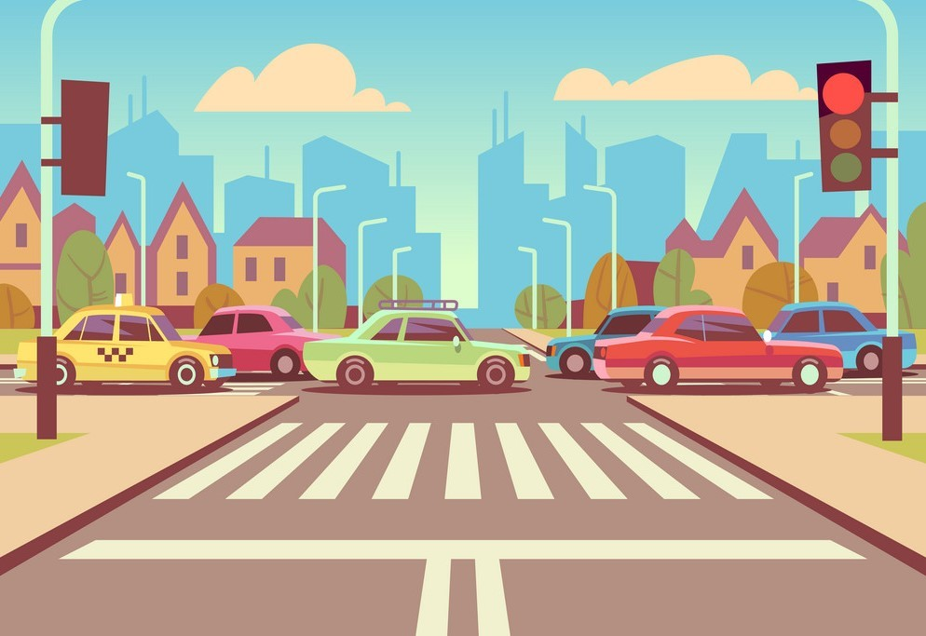
System Architecture
Driver
Vehicle
Environment
Distraction
Speed
Lights
...
...
...
Fatigue
Lateral offse
Padestrian
Perception Module
Situation Assessment Module
Actuator
Decision Making Module
Module

Slide 10
Structure of the System
To address distraction recognition in both daytime and nighttime, this work proposes using two recognition modes: an RGB mode and an NIR mode.
The RGB mode is activated in the daytime and uses images collected from an RGB camera to identify distraction.
The NIR mode, on the other hand, is activated in the nighttime and uses an NIR camera. In each mode, the system identifies distraction by a CNN image classifier.
To know which mode to activate at any given time, the system uses a light sensor to estimate the in vehicle luminance conditions.
If the luminance is above a certain threshold, the RGB mode is triggered, otherwise, the NIR mode is activated.

Slide 11
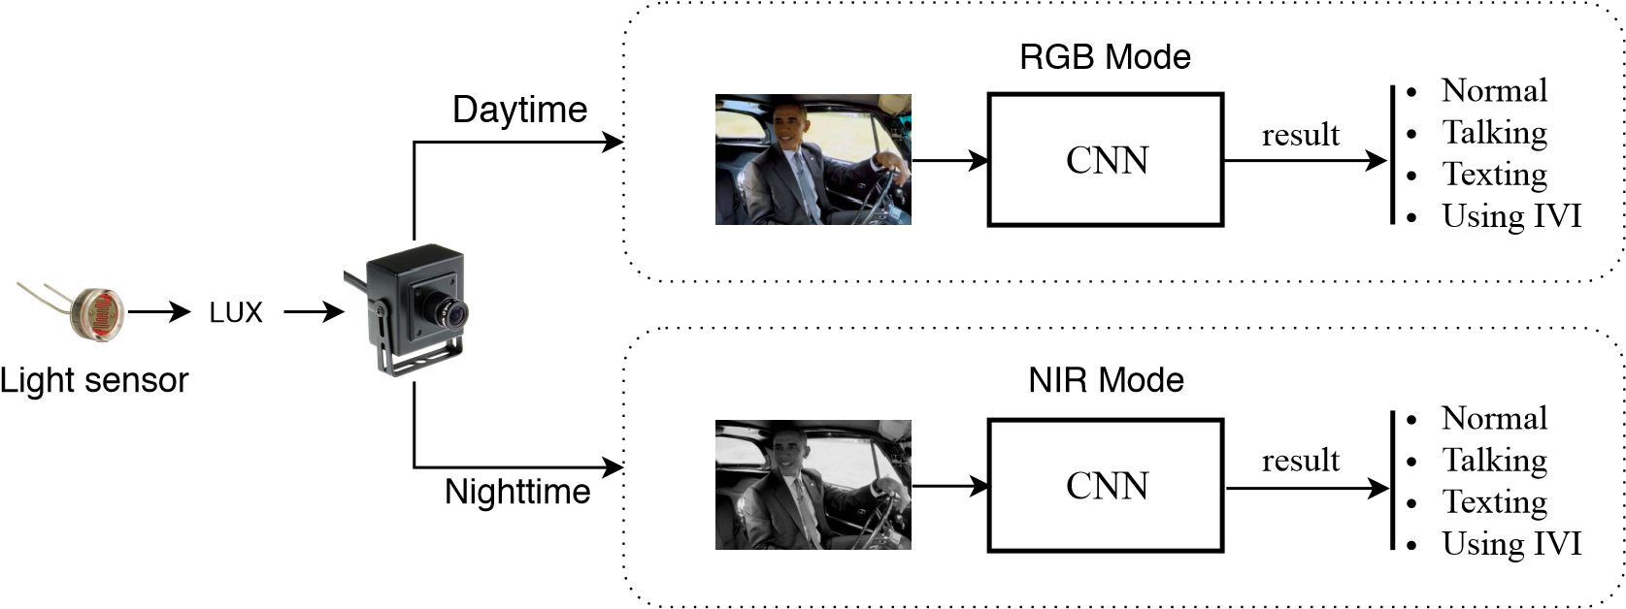
A Schematic representation of the system

Slide 12
Algorithms
Support Vector Machine Algorithm (SVM )
A support vector machine (SVM) is a supervised machine learning algorithm that can be used for both classification and regression purposes. SVM are mostly used in classification problems.
SVM are founded on the idea of finding a hyperplane that best divides a dataset into two classes.
Because of this, they can be considered the critical elements of a data set.
The aim is to choose a hyperplane with the greatest possible margin between the hyperplane and any point within the training set, giving a higher chance of new data being classified correctly

Slide 13
Convolutional Neural Network
A Convolutional Neural Network (CNN) is a Deep Learning algorithm which can take in an input image, assign importance to various aspects/objects in the image and be able to differentiate one from the other.
CNNs are used for image classification and recognition because of its high accuracy .
The CNN follows a hierarchical model which works on building a network, like a funnel, and finally gives out a fully-connected layer where all the neurons are connected to each other and the output is processed.
The best thing about CNN is there is no need for feature extraction. Now, convolutional neural networks can extract informative features from images, eliminating the need of traditional manual image processing methods.

Slide 14
Entity Relationship Diagrams
Entity relationship diagrams provide a visual starting point for database design that can also be used to help determine information system requirements throughout an organisation. After a relational database is rolled out, an ERD can still serve as a reference point, should any debugging or business process re-engineering be needed later.
However, while an ERD can be useful for organising data that can be represented by a relational structure, it can't sufficiently represent semi-structured or unstructured data. It's also unlikely to be helpful on its own in integrating data into a pre-existing information system.

Slide 15
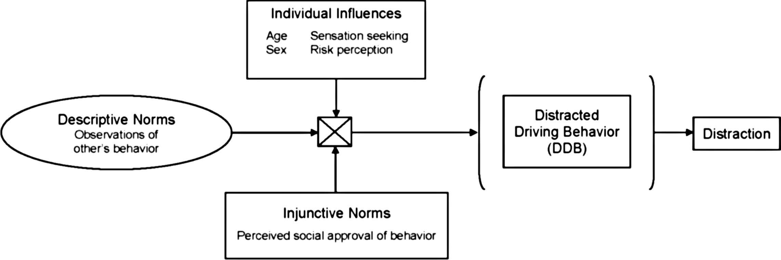
Entity relationship diagram

Slide 16
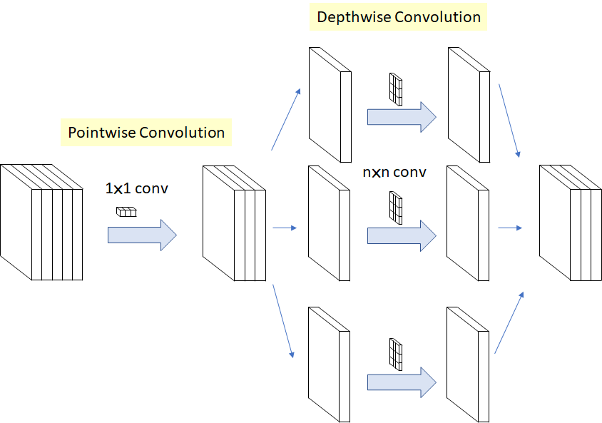
UML Diagram

Slide 17
PROJECT SCHEDULE
Requirement Analysis
Requirement Specification
System Design
Coding
Testing
Implementation
Maintanance

Slide 18
Project Plan
Project Finalisation
Study of Literature Survey
Architecture Design
Requirement Analysis
Flow Discussion
Project Implementation
Documentation

Slide 19
ADVANTAGES
1. The areas will be prone to lesser accidents.
2.DRIVERS ND PASSENGERS WILL have a safer journey.
3.The driver will be alert while driving.
4.Extremely helpful for the current and future generations.
5.One of the best technologies for day to day application.

Slide 20
CONCLUSION
This work has demonstrated that deep learning models pretrained on the Image net dataset can be fine tuned to classify distracted driver images with good accuracy. The study evaluated twelve pretrained deep convolutional neural network models and retrained them on the State Farm dataset and evaluated its performance on the test dataset. The results indicate a positive outlook on re-purposing the VGG16 model to classify distracted drivers with up to 96% accuracy on unseen images. To summarize the findings in this study, the contribution of this paper is stated as follows: a) Comparing over twelve pretrained CNN models the VGG16 yields the best performance despite having lesser computation layers compared to other models. b) Training strategy S2 always yields better results on all pretrained models at the cost of time and computational resources. In upcoming works, this study will extend the scope to involve an automated architecture search for CNN instead of relying on the predefined architectures. Recent development has shown that this may result in a more efficient and tailored model to the task at hand.

Slide 21
FUTURE SCOPE
For the future improvement of these self-implemented models, we could applied more sophisticated weight initialisation method like Xavier Initialisation or KaiMing Initialisation. Besides, the dataset also provides 77,000 test images without labels, so if these images are labelled or we use semi-supervised learning method, our models could be developed with these images. Finally, we could try out some existing packages from Pytorch or Tensorflow of more complex CNN-based models like ResNet or VGG.The current work can be extended in many ways, some of which are listed as follows.The application scope of the proposed driver distraction recognition system and network is not limit to distraction activities related to electronic devices only. A promising future direction is to extend the current work to include comprehensive images from real driving environments and to test the system for daily driving scenarios.Furthermore, the proposed network architecture may be incorporated into other computer vision applications in computational resource-limited environments. For example, there is an increasing trend to enhance the recognition ability of small-sized robots.

Slide 22
REFERENCES
Johannes Ball´e, Valero Laparra, and Eero P Simoncelli. End-to-end optimized image compression. arXiv preprint arXiv:1611.01704, 2016.Sepp Hochreiter and Ju¨rgen Schmidhuber. Long short-term memory. Neural Computation, 9(8):1735–1780, 1997.Pytorch.
Models. HYPERLINK "https://pytorch.org/docs/stable/torchvision/models.html/" https://pytorch.org/docs/stable/torchvision/ HYPERLINK "https://pytorch.org/docs/stable/torchvision/models.html/" models.htm
"https://pytorch.org/docs/stable/torchvision/models.html/" , 2018. [Online; accessed 18-April-2019].Eric Sun. Shufflenet-v2-Pytorch. HYPERLINK "https://github.com/ericsun99/
/" https://github.com/ericsun99/ HYPERLINK "https://github.com/ericsun99/Shufflenet-v2-Pytorch/" Shufflenet-v2-Pytorch/ HYPERLINK "https://github.com/ericsun99/Shufflenet-v2-Pytorch/" , 2018. [Online; accessed 18-March-2019].Evgeniy Zheltonozhskiy. Impementation of MobileNetV2 in pytorch.
HYPERLINK "https://github.com/Randl/MobileNetV2-pytorch/" https: HYPERLINK "https://github.com/Randl/MobileNetV2-pytorch/" //github.com/Randl/MobileNetV2-pytorch/ HYPERLINK "https://github.com/Randl/MobileNetV2-pytorch/" , 2018. [Online; accessed 18-March2019].UDRIVE.
European drivers spend 10% of the ride on secondary tasks. HYPERLINK "http://www.udrive.eu/index.php/news/145-european-drivers-spend-10-of-the-ride-on-secondary-tasks" http://www.udrive.eu/index.php/news/ HYPERLINK "http://www.udrive.eu/index.php/news/145-european-drivers-spend-10-of-the-ride-on-secondary-tasks" 145-european-drivers-spend-10-of-the-ride-on-secondary-tasks HYPERLINK "http://www.udrive.eu/index.php/news/145-european-drivers-spend-10-of-the-ride-on-secondary-tasks" .
Accessed: 2018-07-18.Thomas A Dingus, Feng Guo, Suzie Lee, Jonathan F Antin, Miguel Perez, Mindy Buchanan-King, and Jonathan Hankey. Driver crash risk factors and prevalence evaluation using naturalistic driving data. Proceedings of the National Academy of Sciences, 113(10):2636–2641, 2016.

Slide 23
Thank You

